Slide 1

Theory of Automata
Formal Languages

Slide 2
Why
Quite often, we've found, teaching theory,
Undergrads are bored, puzzled and weary.
``Sterile proofs are from Hell--
Teach us HTML!''
They don't get it--in turn, we're left teary.
But good theorems don't formally hide
The human emotion supplied
In their proofs' demonstration.
Scientific elation
Belongs not in formaldehyde.
Rigor without mortis, our goal,
Is for sure a negotiable shoal--
We need not run aground.
In our teaching, we've found
A proof's spirit, in verse, is made whole.
Formal methods are meant to elide
Ideas we aspire to confide.
So to ``lemma,'' ``parameter,''
Add ``iambic pentameter.''
This should help students' ennui subside.
Pedagogy's best shown by example.
Ensuite, you are offered a sample
In the hope you're not wincing.
Find our thesis convincing--
We expect explanations are ample.
Martin Cohn
Harry Mairson
Computer Science Department
Brandeis University
Notes:
the inside beauty
enum.txt

Slide 3
Big Picture
Theoretical computer science: is the collection of topics of computer science that focuses on the more abstract, logical and mathematical aspects of computing, such as the theory of computation, analysis of algorithms.
The theory of computation deals with whether and how efficiently problems can be solved on a model of computation (Turing machines, recursive functions, lambda calculus, and production systems), using an algorithm.
  divided into two major branches: computability theory and complexity theory
  both branches deal with formal models of computation
  Computability refers to the ability to solve a problem in an effective manner
  Computational complexity theory classifies problems according to their inherent difficulty
    Analysis of algorithms determines the amount of resources (time, storage) necessary to execute it
  In the last century, theory of computation became an independent academic discipline and was separated from mathematics.
  Some pioneers of the theory of computation were:
    Alonzo Church: Lambda calculus
    Kurt Godel (1906-1978): Incompleteness theorems
    Alan Turing (1912-1954): Turing machine
    Stephen Kleene (1909-1994): Kleene star, regular expression
    John von Neumann (1903-1957): game theory
    Claude Shannon (1916-2001): father of information theory
    Noam Chomsky (1928-): CNF, Chomsky hierarchy
Notes:
John Forbes Nash, a beautiful mind.
Computational complexity theory:
Neighboring fields of study inside theoretical computer science are analysis of algorithms and computability theory. A key distinction between computational complexity theory and analysis of algorithm is that the latter is devoted on analyzing the amount of resources needed by a particular algorithm to solve a concrete problem, whereas the former asks a more general question. Namely, it targets at classifying problems that can, or cannot, be solved with appropriately restricted resources. In turn, imposing restrictions on the available resources distinguishes computational complexity from computability theory: the latter asks what kind of problems can be solved at all (within a given computational model).

Slide 4
Big Picture
In theoretical computer science, automata theory is the study of abstract machines and problems which they are able to solve. It is closely related to formal language theory as the automata are often classified by the class of formal languages they are able to recognize.
  An abstract machine, also called an abstract computer, is a theoretical model of a computer hardware or software system used in automata theory.
  A typical abstract machine consists of a definition in terms of input, output, and the set of allowable operations used to turn the former into the latter. E.g., FSM, PDA, Turing machine.
Formal languages: A set of strings over a given alphabet.
  In contrast to natural language
  Often defined by formal grammar, which is a set of formation rules that describe which strings formed from the alphabet of a formal language are syntactically valid.
  Used for the precise definition of data formats and the syntax of program. languages.
  Play a crucial role in the development of compilers.
  Used in logic / foundations of mathematics to represent the syntax of formal theories
  Regular languages, context-free languages, context-sensitive languages, recursive languages (decidable), recursively enumerable languages (semi-decidable)
  Formal language theory uses separate formalisms, automata, to describe their recognizers.

Slide 5
Grammars, Languages, and Machines
Generates
Language
Grammar
Recognizes
Machine

Slide 6
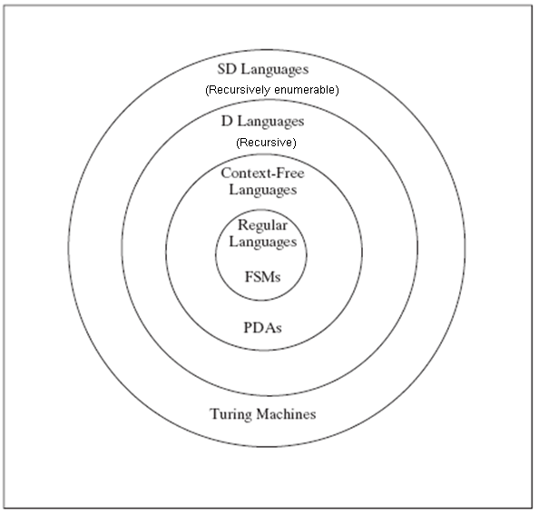
Languages and Machines

Slide 7
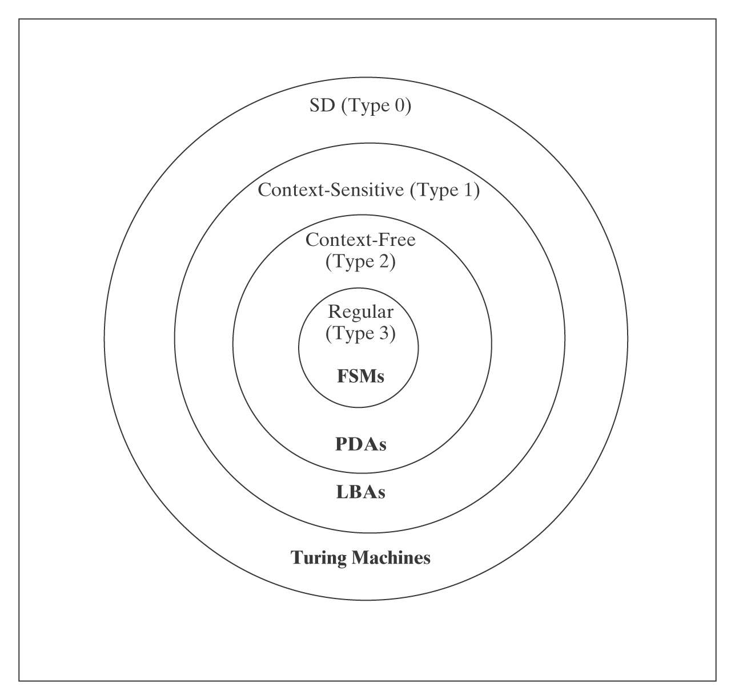
The Chomsky Hierarchy
(Recursively enumerable)
Recursive languages (decidable) are not included

Slide 8
The Chomsky Hierarchy
Grammar | Languages | Automaton | Production rules (constraints)
Type-0 | Recursively enumerable | Turing machine | (no restrictions)
Type-1 | Context-sensitive | Linear-bounded non-deterministic Turing machine
Type-2 | Context-free | Non-deterministic pushdown automaton
Type-3 | Regular | Finite state automaton
Summarizes each of Chomsky's four types of grammars, the class of language it generates, the type of automaton that recognizes it, and the form its rules must have.
There are other categories of formal languages not included, e.g., recursive

Slide 9
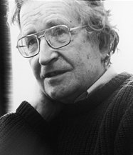
Noam Chomsky
1928 –
Professor emeritus at MIT
Father of modern linguistics
Still holds office
Chomsky normal form (CNF)
  context-free grammar
Controversial political critic
Often receives undercover police protection

Slide 10
Mathematical Background
Appendix A

Slide 11
Boolean Logic Wffs
A wff is any string that is formed according to the following rules:
A propositional symbol (or variable) is a wff.
If P is a wff, then ¬P is a wff.
If P and Q are wffs, then so are:
    P ∨ Q, P ∧ Q, P → Q, and P ↔ Q.
If P is a wff, then (P) is a wff.
Notes:
A proposition is a statement that has a truth value.

Slide 12
Truth Tables Define Operators
P | Q | ¬P | P ∨ Q | P ∧ Q | P → Q | P ↔ Q
True | True | False | True | True | True | True
True | False | False | True | False | False | False
False | True | True | True | False | True | False
False | False | True | False | False | True | True
Notes:
Iff

Slide 13
When Wffs are True
A Boolean wff is valid or is a tautology iff it is true for all assignments of truth values to the variables it contains.
A Boolean wff is satisfiable iff it is true for at least one assignment of truth values to the variables it contains.
A Boolean wff is unsatisfiable iff it is false for all assignments of truth values to the variables it contains.
Two wffs P and Q are equivalent, written P ≡ Q, iff they have the same truth values regardless of the truth values of the variables they contain.

Slide 14
Using Truth Tables
P ∨ ¬P is a tautology:
P | ¬P | P ∨ ¬P
True | False | True
False | True | True

Slide 15
Properties of Boolean Operators
∨ and ∧ are commutative and associative.
↔ is commutative but not associative.
∨ and ∧ are idempotent:
    (e.g., (P ∨ P) ≡ P).
∨ and ∧ distribute over each other:
  P ∧ (Q ∨ R) ≡ (P ∧ Q) ∨ (P ∧ R).
  P ∨ (Q ∧ R) ≡ (P ∨ Q) ∧ (P ∨ R).
Notes:
^: Conjunction (and)
v: disjunction (or)
Negation (not)
-> conditoinal (if … then)
<->: biconditional (iff)
Idempotent: multiple applications of the operation do not change the result

Slide 16
More Properties
Absorption laws:
  P ∧ (P ∨ Q) ≡ P.
  P ∨ (P ∧ Q) ≡ P.
Double negation: ¬¬P ≡ P.
de Morgan’s Laws:
  ¬(P ∧ Q) ≡ (¬P ∨ ¬Q).
  ¬(P ∨ Q) ≡ (¬P ∧ ¬Q).
Notes:
Double negation: also referred to as involution

Slide 17
Entailment
A set A of wffs logically implies or entails a conclusion Q iff, whenever all of the wffs in A are true, Q is also true.
Example:
A ∧ B ∧ C entail A → D
D

Slide 18
Inference Rules
An inference rule is sound iff, whenever it is applied to a set A of axioms, any conclusion that it produces is entailed by A. An entire proof is sound iff it consists of a sequence of inference steps each of which was constructed using a sound inference rule.
A set of inference rules R is complete iff, given any set A of axioms, all statements that are entailed by A can be proved by applying the rules in R.

Slide 19
Some Sound Inference Rules
Modus ponens: From (P → Q) and P,
        conclude Q.
Modus tollens: From (P → Q) and ¬Q,
conclude ¬P.
Or introduction: From P, conclude (P ∨ Q).
And introduction: From P and Q, conclude
(P ∧ Q).
And elimination: From (P ∧ Q), conclude P
or conclude Q.

Slide 20
First-Order Logic
A well-formed formula (wff) in first-order logic is an expression that can be formed by:
If P is an n-ary predicate and each of the expressions x₁, x₂, … , x_{n} is a term, then an expression of the form P(x₁, x₂, … , x_{n}) is a wff. If any variable occurs in such a wff, then that variable is free.
If P is a wff, then ¬P is a wff.
If P and Q are wffs, then so are P ∨ Q, P ∧ Q, P → Q, and P ↔ Q.
If P is a wff, then (P) is a wff.
If P is a wff, then ∀x (P) and ∃x (P) are wffs. Any free instance of x in P is bound by the quantifier and is then no longer free.
Notes:
Primitives in boolean logic are predicates of no arguments
FOL allows the use of variables

Slide 21
Sentences
A wff with no free variables is called a sentence or a statement.
Bear(Smoky).
∀x (Bear(x) → Animal(x)).
∀x (Animal(x) → Bear(x)).
∀x (Animal(x) → ∃y (Mother-of(y, x))).
∀x ((Animal(x) ∧ ¬Dead(x)) → Alive(x)).
A ground instance is a sentence that contains no variables.
Notes:
In plain english?

Slide 22
Truth
Bear(Smoky).
∀x (Bear(x) → Animal(x)).
∀x (Animal(x) → Bear(x)).
∀x (Animal(x) → ∃y (Mother-of(y, x))).
∀x ((Animal(x) ∧ ¬Dead(x)) → Alive(x)).
Which of these are true in the everyday world?
Notes:
3

Slide 23
Interpretations and Models
An interpretation for a sentence w is a pair (D, I), where D is a universe of objects. I assigns meaning to the symbols of w: it assigns values, drawn from D, to the constants in w and it assigns functions and predicates (whose domains and ranges are subsets of D) to the function and predicate symbols of w.
A model of a sentence w is an interpretation that makes w true. For example, let w be the sentence:
  ∀x (∃y (y < x)).
A sentence w is valid iff it is true in all interpretations.
A sentence w is satisfiable iff there exists some interpretation in which w is true.
A sentence w is unsatisfiable iff ¬w is valid.
Notes:
Determining whether or not a sentence is true requires appeal to the meanings of the constants, functions, and predicates that it contains.
The integers (along with the usual meaning of <) are a model of w since, for any integer, there exists some smaller integer.
The positive integers, on the other hand, are an interpretation for w but not a model of it. The sentence w is false for the positive integers since there is no positive integer that is smaller than 1.

Slide 24
Examples
∀x ((P(x) ∧ Q(Smoky)) → P(x)).
¬(∀x (P(x) ∨ ¬(P(x))).
∀x (P(x, x)).
Notes:
Valid
Unsatisfiable
Satisfiable: suppose that the universe is the integers and P is the predicate LessThanOrEqualTo, then P is true for all values of x.
Suppose P is LessThan, then P is false for all values of x.

Slide 25
Additional Sound Inference Rules
Quantifier exchange:
  From ¬∃x (P), conclude ∀x (¬P).
  From ∀x (¬P), conclude ¬∃x (P).
  From ¬∀x (P), conclude ∃x (¬P).
  From ∃x (¬P), conclude ¬∀x (P) .
Universal instantiation: For any constant C, from ∀x (P(x)), conclude P(C).
Existential generalization: For any constant C, from P(C) conclude ∃x (P(x)).

Slide 26
A Simple Proof
Assume the following three axioms:
[1] ∀x (P(x) ∧ Q(x) → R(x)).
[2] P(X₁).
[3] Q(X₁).
We prove R(X₁) as follows:
[4] P(X₁) ∧ Q(X₁) → R(X₁). (Universal instantiation, [1].)
[5] P(X₁) ∧ Q(X₁). (And introduction, [2], [3].)
[6] R(X₁). (Modus ponens, [5], [4].)

Slide 27
Theory
A first order theory is a set of axioms and the set of all theorems that can be proved, using a set of sound and complete inference rules, from those axioms.
A theory is consistent iff there is no sentence P such that both P and ¬ P are theorems.
  inconsistent: contains such a contradiction.
Let w be a world plus an interpretation (that maps logical objects to objects in the world). We say a theory is sound w.r.t. w iff every theorem in the theory corresponds to a fact that is true in w.
We say a theory is complete w.r.t. w iff every fact that is true in w corresponds to a theorem in the theory.

Slide 28
Gödel’s Theorems
Completeness Theorem: there exists some set of inference rules R such that, given any set of axioms A and a sentence c, there is a proof of c, starting with A and applying the rules in R, iff c is entailed by A.
Incompleteness Theorem: any theory that is derived from a decidable set of axioms and that characterizes the standard behavior of the constants 0 and 1, plus the functions plus and times on the natural numbers, cannot be both consistent and complete.

Slide 29
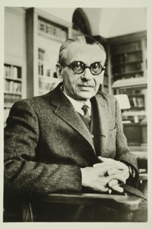
Kurt Gödel
1906 – 1978. One of the greatest logicians of all time
Gödel and Einstein … were known to take long walks together to and from the Institute for Advanced Study. … toward the end of his life Einstein confided that his "own work no longer meant much, that he came to the Institute merely…to have the privilege of walking home with Gödel. "
1947, Einstein … accompanied Gödel to his U.S. citizenship exam, where they acted as witnesses. Gödel had confided in them that he had discovered an inconsistency in the U.S. Constitution, one that would allow the U.S. to become a dictatorship
In later life, suffered periods of mental instability… fear of being poisoned; wouldn't eat unless his wife tasted his food for him. Late in 1977, wife was hospitalized for six months. In her absence, he refused to eat, eventually starving himself to death. He weighed 65 pounds when he died.

Slide 30
Extensions
Propositional logic
First order logic: use variables
  Range over individuals
Second order logic
  Additional variables that range over sets of individuals
  E.g., ∀P∀x(x ∈ P ∨ x ∉ P).
Higher order logic
  A predicate can take one or more other predicates as argumetns

Slide 31
Sets
S₁ = {13, 11, 8, 23}.
S₂ = {8, 23, 11, 13}.
S₃ = {8, 8, 23, 23, 11, 11, 13, 13}.
S₄ = {apple, pear, banana, grape}.
S₅ = {January, February, March, April, May, June, July, August, September, October, November, December}.
S₆ = {x : x ∈ S₅ and x has 31 days}.
S₇ = {January, March, May, July, August, October, December}.
Notes:
: such that
S6 and S7 are the same
Sets S1, S2, and S3 are equal

Slide 32
Sets
ℕ = the nonnegative integers (also called the natural numbers).
Z = the integers ( … -3, -2, -1, 0, 1, 2, 3, …).

Slide 33
Sets
S₈ = {i : ∃x ∈ ℕ (i = 2x)}.
S₉ = {0, 2, 4, 6, 8, …}.
S₁₀ = the even natural numbers.
S₁₁ = the syntactically valid C programs.
S₁₂ = {x : x ∈ S₁₁ and x never gets into an infinite loop}.
S₁₃ = {finite length strings of a’s and b’s}.

Slide 34
Defining a Set Using Programs
Write a program that enumerates the elements of S.
Write a program that decides S by implementing the characteristic function of S. Such a program returns True if run on some element that is in S and False if run on an element that is not in S.
  A characteristic function can be used to determine whether or not a given element is in S.

Slide 35
Cardinality
The cardinality of every set we will consider is:
a natural number (if S is finite),
“countably infinite” (if S has the same number of elements as there are integers), or
“uncountably infinite” (if S has more elements than there are integers).
Empty set φ
  so | φ | = 0.
  |{φ}| = ?

Slide 36
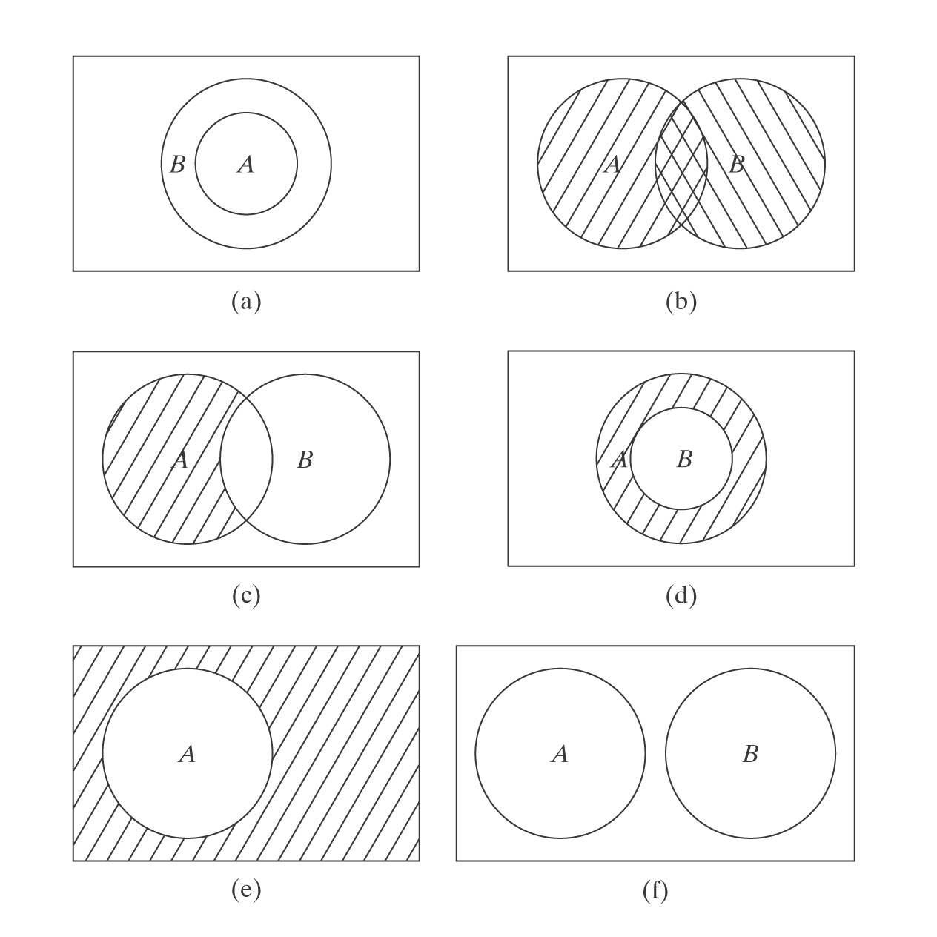
Relating Sets to Each Other
Notes:
Venn diagrams illustrating relations and functions on sets.
Union, intersection, difference, complement, disjount

Slide 37
Sets of Sets
The power set of A is the set of all subsets of A.
Let A = {1, 2, 3}. Then:
P(A) = {∅, {1}, {2}, {3}, {1, 2}, {1, 3}, {2, 3}, {1, 2, 3}}.
Π ⊆ P(A) is a partition of a set A iff:
  no element of Π is empty,
  all pairs of elements of Π are disjoint , and
  the union of all the elements of Π equals A.
Partitions of A:
{{1}, {2, 3}} or {{1, 3}, {2}} or {{1, 2, 3}}.

Slide 38
What is a Relation?
An ordered pair is a sequence of two objects, written:
(x, y).
Order matters. So (unless x and y are equal):
(x, y) ≠ (y, x).

Slide 39
Cartesian Products
The Cartesian product of two sets A and B is the set of all ordered pairs (a, b) such that a ∈ A and b ∈ B. We write it as:
A × B
If A and B are finite, the cardinality of their Cartesian product is:
|A × B| = |A|⋅|B|.

Slide 40
Cartesian Products
Let A be: {Dave, Sara, Billy}
Let B be: {cake, pie, ice cream}
A × B = { (Dave, cake), (Dave, pie),
(Dave, ice cream), (Sara, cake),
(Sara, pie), (Sara, ice cream),
(Billy, cake), (Billy, pie), (Billy, ice cream)}.
B × A = { (cake, Dave), (pie, Dave),
(ice cream, Dave),
(cake, Sara), (pie, Sara), (ice cream, Sara),
(cake, Billy), (pie, Billy), (ice cream, Billy)}.

Slide 41
Binary Relations
A binary relation over two sets A and B is a subset of:
A × B.
Example:
Dessert = { (Dave, cake), (Dave, ice cream),
(Sara, pie), (Sara, ice cream)}
Dessert ⁻¹ = { (cake, Dave), (ice cream, Dave),
(pie, Sara), (ice cream, Sara)}
Binary relations are particularly useful and are often written as x R y.
Notes:
Inverse of a binary relation

Slide 42
Relations
3-ary (ternary) relation: A × A × A
{(Sara, Dave, Billy), (Beth, Mark, Cathy), (Cathy, Billy, Pete)}
An n-ary relation over sets A₁, A₂, … A_{n} is a subset of:
A₁ × A₂ × … × A_{n}.
A relation may be equal to {}
  Dave, Sue, and Billy all hate dessert
no constraints on how many times a particular element may occur in a relation

Slide 43
Composing Relations
The composition of R₁ ⊆ A × B and R₂ ⊆ B × C,
written R₂ ° R₁, is:
R₂ ° R₁ = {(a, c) : ∃b ((a, b) ∈ R₁ ∧ ((b, c) ∈ R₂)}
R₂ ° R₁ ⊆ A × C
R₁ ° R₂ is fine, as long as consistent
Dessert = {(Dave, cake), (Dave, ice cream), (Sara, pie),
(Sara, ice cream)}
Fatgrams = {(cake, 30), (pie, 25), (ice cream, 15)}
Fatgrams ° Dessert = {(Dave, 30), (Dave, 15),
(Sara, 25), (Sara, 15)}

Slide 44
Representing Relations
Ways to represent a binary relation R:
List the elements of R.
Mother-of = {(Doreen, Ann), (Ann, Catherine), (Catherine, Allison)}
Write a procedure that defines R either by:
  Enumerating it.
  Deciding it.
Encode R as an adjacency matrix.
Encode R as a directed graph.

Slide 45
Representing a Binary Relation as an Adjacency Matrix
 | Doreen | Ann | Catherine | Allison
Doreen |  | 1
Ann |  |  | 1
Catherine |  |  |  | 1
Allison

Slide 46
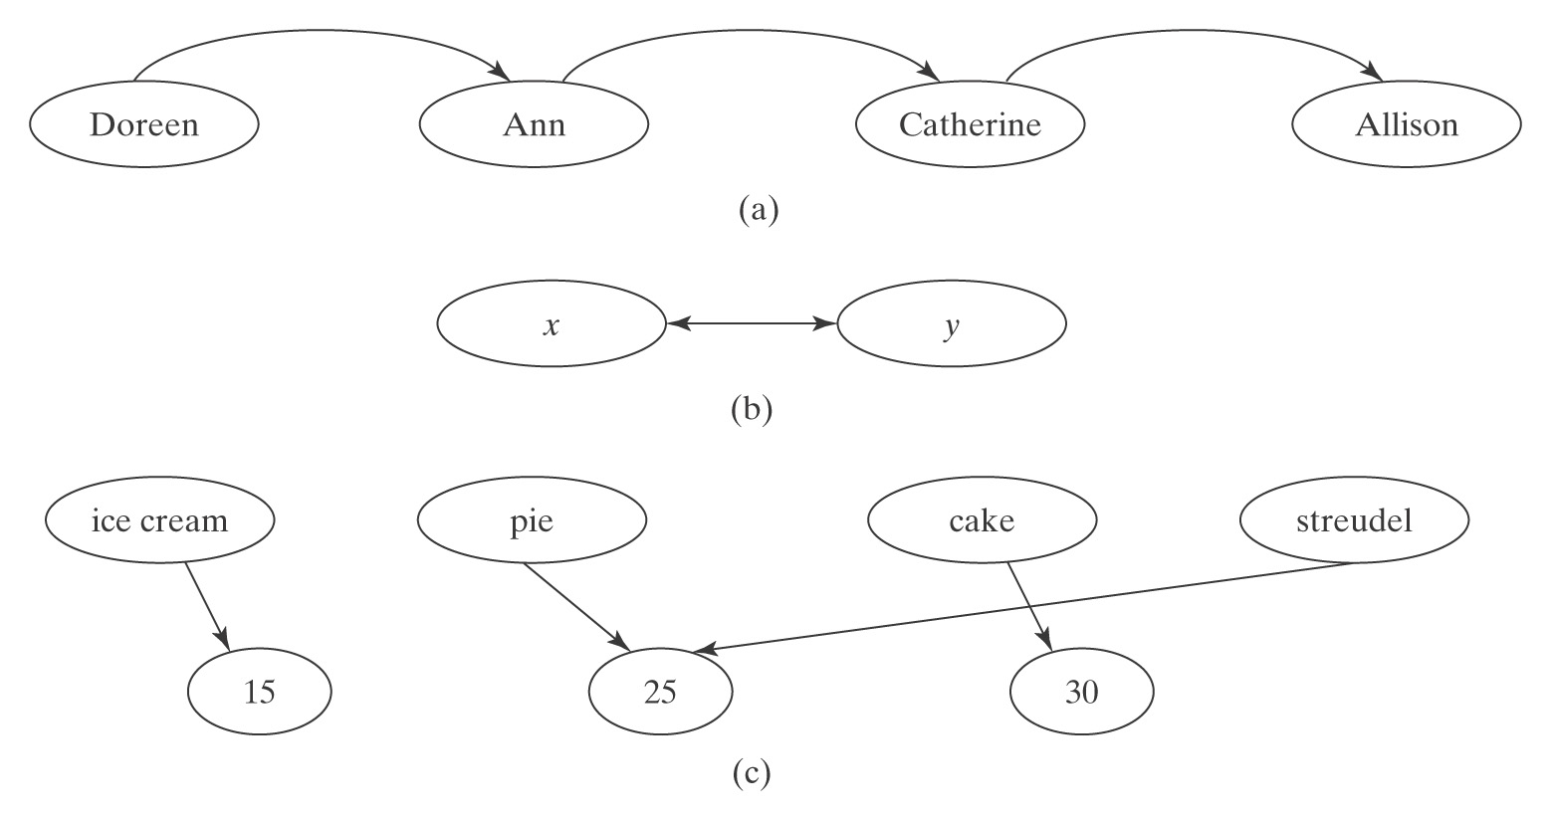
Representing Binary Relations as Graphs
Notes:
b. If there are two elements x and y, and both (x, y) and (y, x) are in R, we will usually draw a graph as shown in b. note, it’s not a directed graph, to be precise. Also common, undirected graph.
c. Directed graph technique also applies if R is a relation over two different sets A and B. see c for the Fatgrams relation.
Usually, a bipartite graph.
Then, how about A x B x C … hypergraphs …

Slide 47
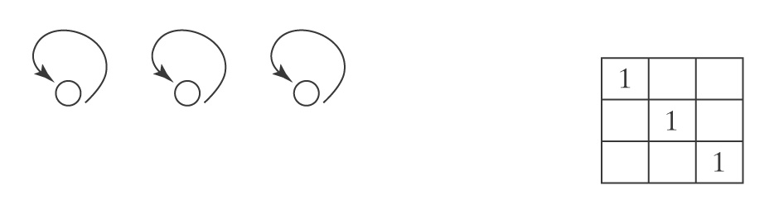
Properties of Relations
R ⊆ A × A is reflexive iff, ∀x ∈ A ((x, x) ∈ R).
Examples:
≤ defined on the integers. For every integer x, x ≤ x.
Notes:
Representing a reflexive relation

Slide 48
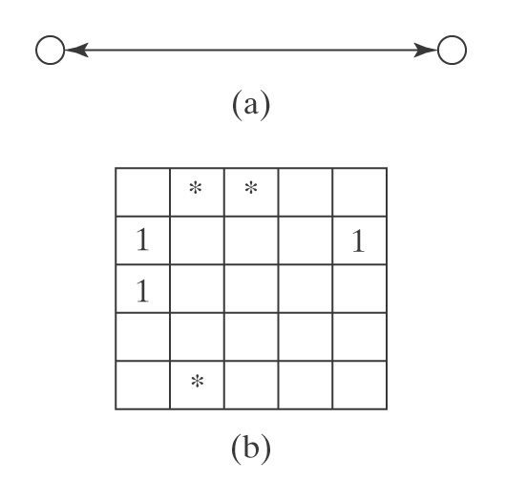
Properties of Relations
R ⊆ A × A is symmetric iff ∀x, y ((x, y) ∈ R → (y, x) ∈ R).
Examples:
= is symmetric.
≤ is not symmetric.

Slide 49
Properties of Relations
R ⊆ A × A is antisymmetric iff
∀x, y ((x, y) ∈ R ∧ x ≠ y → (y, x) ∉ R)
Examples?
R ⊆ A × A is transitive iff
∀x, y, z (((x, y) ∈ R ∧ (y, z) ∈ R → (x, z) ∉ R)
Examples?

Slide 50
Equivalence Relations
A relation R ⊆ A × A is an equivalence relation iff it is:
  reflexive,
  symmetric, and
  transitive.
Examples:
  Equality
  Lives-at-Same-Address-As
  Same-Length-As

Slide 51
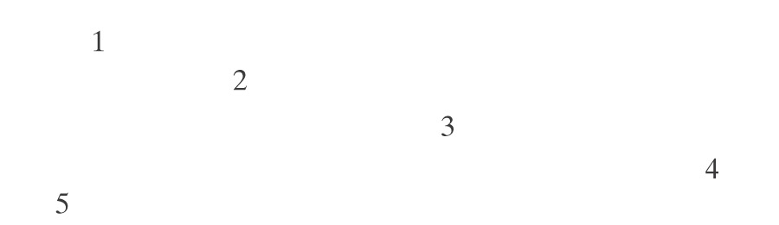
Equivalence Classes
Make it reflexive:

Slide 52
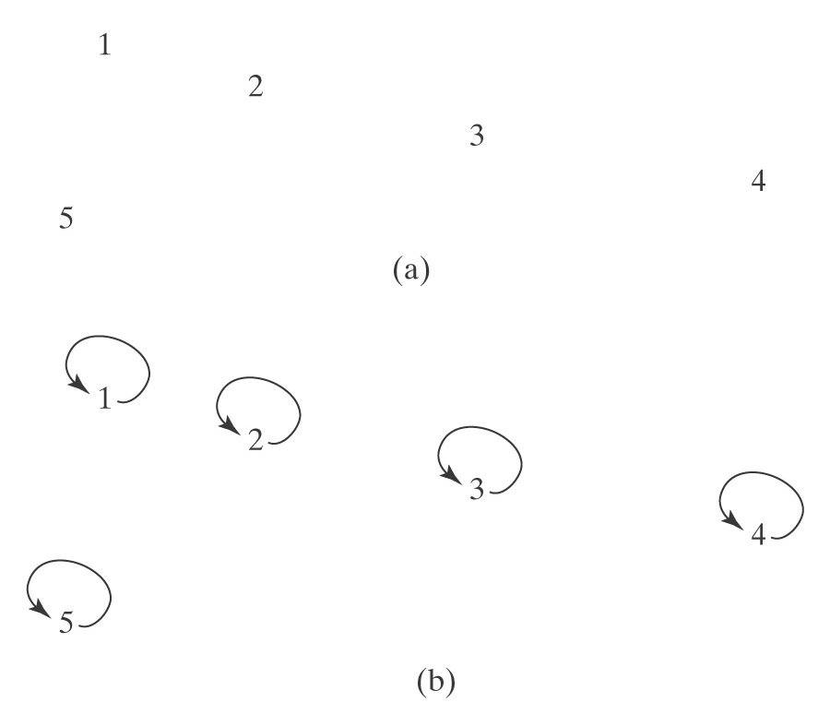
Equivalence Classes
Add (1, 2):

Slide 53
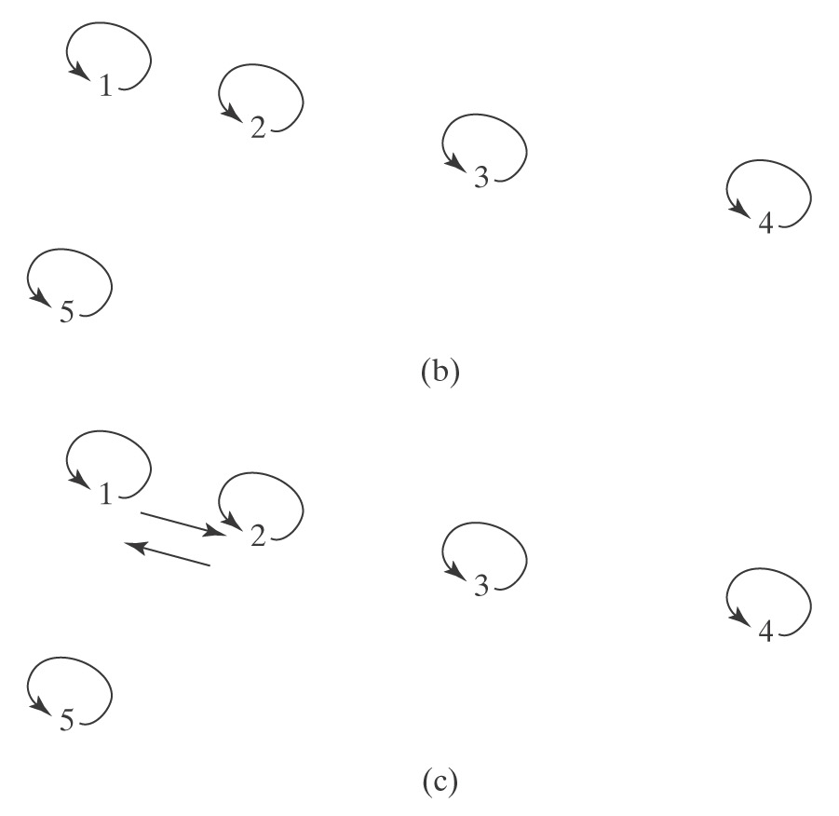
Equivalence Classes
Add (2, 3):

Slide 54
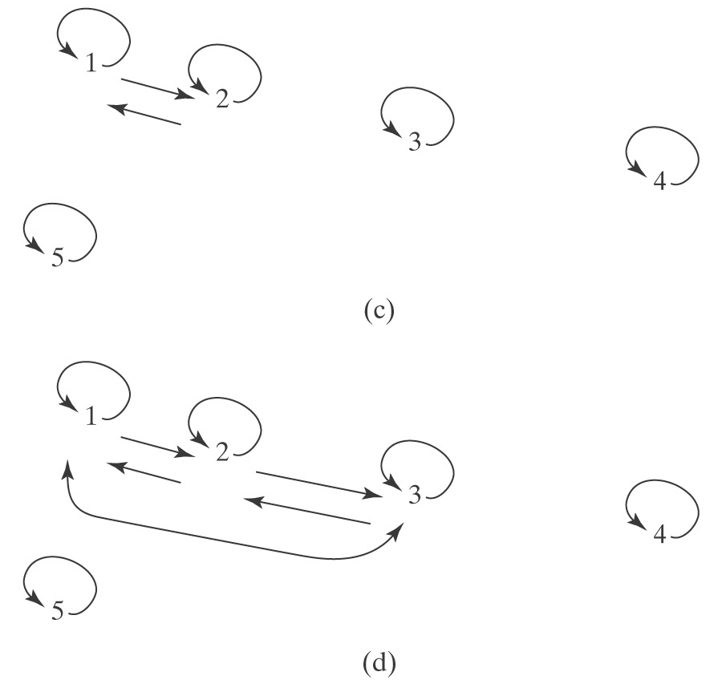
Equivalence Classes

Slide 55
Equivalence Classes
An equivalence relation R on a set S carves S up into a set of clusters or islands, which we’ll call equivalence classes. This set of equivalence classes has the following key property:
∀s, t ∈ S ((s ∈ class_{i} ∧ (s, t) ∈ R) → t ∈ class_{i}).
If R is an equivalence relation on a nonempty set A, then the set of equivalence classes of R is a partition Π of A. Because Π is a partition iff:
(a) no element of Π is empty;
(b) all members of Π are disjoint; and
(c) the union of all the elements of Π equals A.

Slide 56
Equivalence Classes
To describe equivalence classes, we’ll use the notation [x] to mean the equivalence class to which x belongs.
In general, there are maybe lots of different ways to describe the same equivalence class.
For example, [1], [2], [3] all describe the same equivalence class S that contains 1, 2, and 3

Slide 57
Partial Orders
A partial order is a relation that is:
  reflexive
  antisymmetric
  transitive
Let R be a partial order defined on a set A. Then the pair (A, R) is a partially ordered set.
Subset-of is a partial order defined on the set of all sets
Proper-Subset-of?
Notes:
Not reflexive

Slide 58
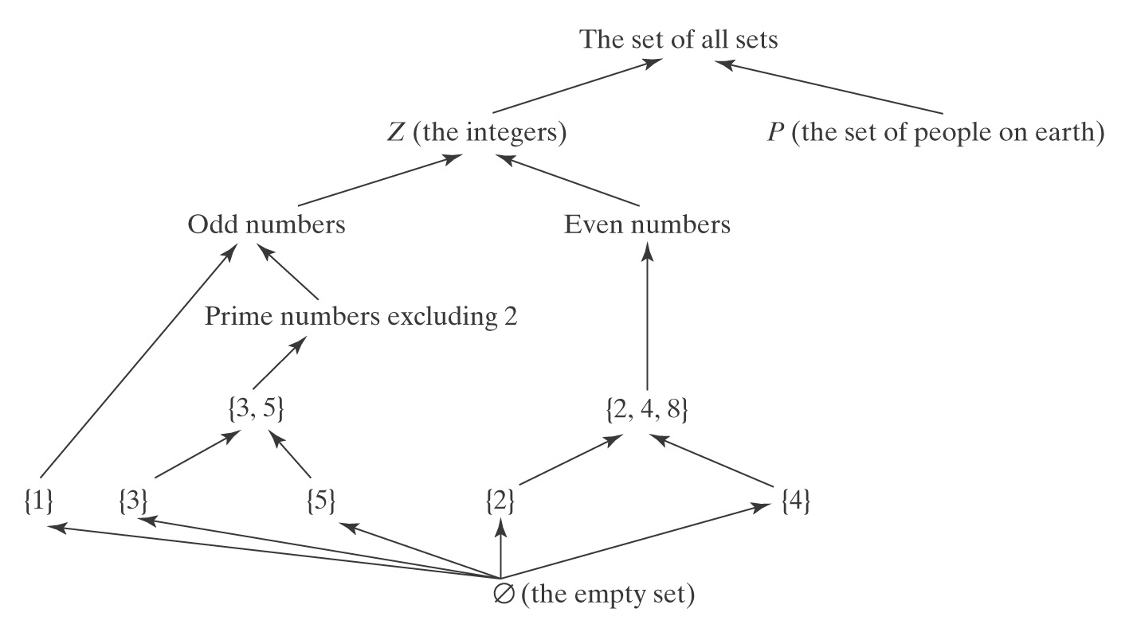
Subset-of is a Partial Order
To make the graph relatively easy to read, we follow the convention that we do not write in the links that are required by reflexivity and transitivity.

Slide 59
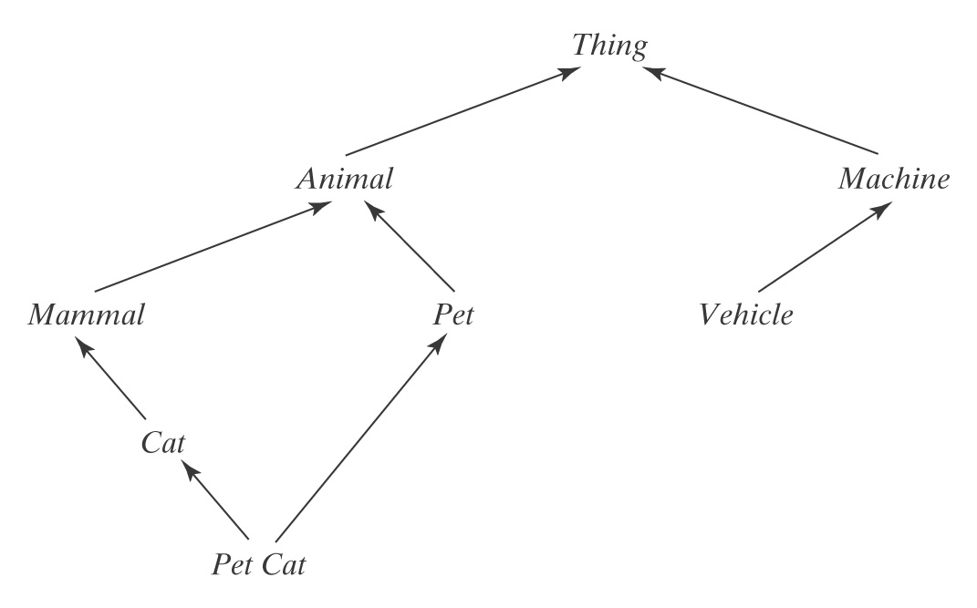
A Concept Hierarchy
A concept is a set of entities in the world.
Some concepts are more general than others.
We say a concept x is subsumed by a concept y (x ≤ y) iff every instance of x is also an instance of y.
Concept subsumption is a partial order.

Slide 60
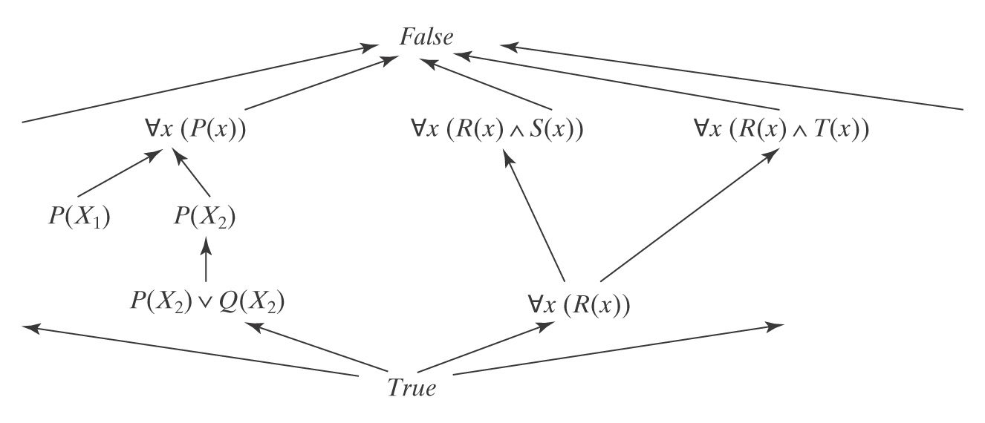
A Subsumption Lattice

Slide 61
Total Orders
A total order R ⊆ A × A is a partial order that has the additional property that:
∀x, y ∈ A ((x, y) ∈ R ∨ (y, x) ∈ R).
Example: ≤
If R is a total order defined on a set A, then the pair (A, R) is a totally ordered set.
6
5
4
3

Slide 62
Well-Founded and Well-Ordered Sets
Given a partially ordered set (A, R), an infinite descending chain is a totally ordered, with respect to R, subset B of A that has no minimal element.
If (A, R) contains no infinite descending chains then it is called a well-founded set.
  Used for halting proofs.
If (A, R) is a well-founded set and R is a total order, then (A, R) is called a well-ordered set.
  Used in induction proofs.

Slide 63
Well-Founded and Well-Ordered Sets
(A, R) | Well-founded | Well-ordered
The set of sets with respect to the subset-of relation | Yes | No
The set of concepts with respect to subsumption | Yes | No
The set of natural numbers under ≤ | Yes | Yes
The set of integers under ≤ | No | No

Slide 64
Functions
A function f from a set A to a set B is a binary relation, subset of A × B, such that:
∀x∈A ((((x, y) ∈ f ∧ (x, z) ∈ f) → y = z) ∧ ∃y∈B ((x, y) ∈ f )).
i.e., each element in A relates to exactly one element in B.
one to one is ok, many to one is ok, but not one to many
Dessert =
{ (Dave, cake),
(Dave, ice cream),
(Sara, pie),
(Sara, ice cream)} is not a function.
succ(n) = n + 1 is a function.

Slide 65
Notations of Functions
f : A → B
  A: domain
  B: codomain or range
  f is a function from A to B
Can define a function in two parts
  the first specifies the domain and range
  the second defines how elements are related
  succ: Z -> Z,
  succ(n) = n + 1.
succ is a unary function
+: (Z x Z) -> Z is a binary function

Slide 66
Properties of Functions
f : A → B is one-to-one iff no two elements of A map to the same element of B.
  injective
  f is a injection
f : A → B is onto iff every element of B is the value of some element of A.
  surjective
  f is a surjection
  the elements of B are covered
f : A → B is bijective if it is both injective and surjective
  f is a bijection
the inverse of a bijection is also a function
if f ⊆ A × B, then f⁻¹ ⊆ B × A = {(b, a): (a,b) ∈ f}

Slide 67
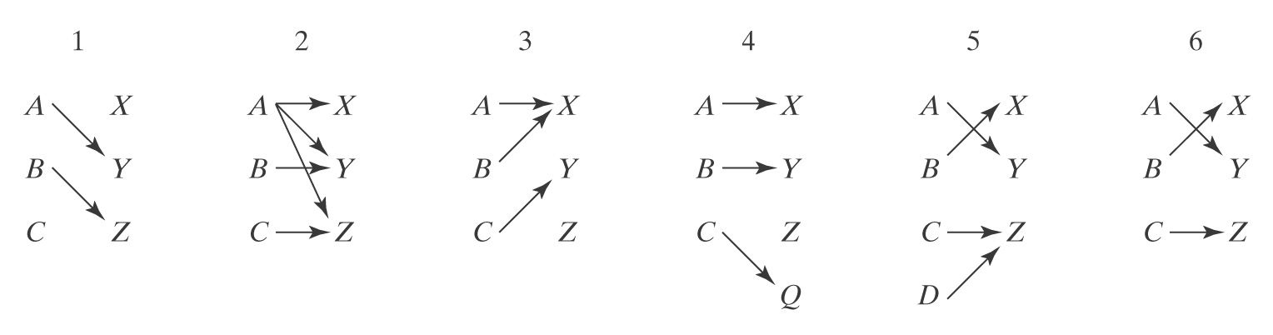
Properties of Functions
Notes:
1: is a function but not total, now we only consider total functions, where all elements in the domain are covered.
2: not a function
3: function, but neither one to one nor onto
4: one to one but not onto
5: not one to one, but onto
6. bijection

Slide 68
Properties of Binary Functions
A binary function # is commutative iff:
∀x, y ∈ A (x # y = y # x).
i + j = j + i. (integer addition)
A ∩ B = B ∩ A. (set intersection)
P ∧ Q ≡ Q ∧ P. (Boolean and)
A binary function # is associative iff:
∀x, y, z ∈ A ((x # y) # z = x # (y # z)).
(i + j) + k = i + (j + k). (integer addition)
(A ∩ B) ∩ C = A ∩ (B ∩ C). (set intersection)
(P ∧ Q) ∧ R ≡ P ∧ (Q ∧ R). (Boolean and)
(s || t) || w = s || (t || w). (string concatenation)

Slide 69
Properties of Binary Functions
A binary function # is idempotent iff ∀x ∈ A (x # x = x).
min(i, i) = i. (integer minimum)
A ∩ A = A. (set intersection)
P ∧ P ≡ (Boolean and)
The distributivity property: A function # distributes over another function % iff:
∀x, y, z ∈ A (x # (y % z) = (x # y) % (x # z)).
i⋅(j + k) = (i⋅j) + (i⋅k). (integer multiplication
over addition)
A ∪ (B ∩ C) = (A ∪ B) ∩ (A ∪ C). (set union over
intersection)
P ∧ (Q ∨ R) ≡ (P ∧ Q) ∨ (P ∧ Q). (Boolean and over or)

Slide 70
Properties of Binary Functions
Absorption laws also relate two binary functions to each other:
A function # absorbs another function % iff:
∀x, y ∈ A (x # (x % y) = x)).
A ∩ (A ∪ B) = A. (Set intersection absorbs
union.)
P ∨ (P ∧ Q) ≡ P. (Boolean or absorbs and.)
P ∧ (P ∨ Q) ≡ P. (Boolean and absorbs or.)

Slide 71
Identities
An element a is an identity for the function # iff:
∀x ∈ A ((x # a = x) ∧ (a # x = x)).
i⋅1 = i. (1 is an identity for integer
multiplication.)
i + 0 = i. (0 is an identity for integer
addition.)
A ∪ ∅ = A. (∅ is an identity for set union.)
P ∨ False ≡ P. (False is an identity for Boolean
or.)
s || "" = s. ("" is an identity for string
concatenation.)

Slide 72
Zeros
An element a is a zero for the function # iff:
∀x ∈ A ((x # a = a) ∧ (a # x = a)).
i⋅0 = 0. (0 is a zero for integer
multiplication.)
A ∩ ∅ = ∅. (∅ is a zero for set
intersection.)
P ∧ False ≡ False. (False is a zero for Boolean
and.)

Slide 73
Self Inverses
A unary function $ is a self inverse iff:
∀x ($($(x)) = x).
-(-(i)) = i. (Multiplying by -1 is a self
inverse for integers.)
1/(1/i) = i if i ≠ 0. (Dividing into 1 is a self inverse
for integers.)
¬¬A = A. (Complement is a self inverse
for sets.)
¬(¬ P) = P. (Negation is a self inverse for
Booleans.)
(s^{R})^{R} = s. (Reversal is a self inverse for
strings.)

Slide 74
Properties of Functions on Sets
Commutativity: A ∪ B = B ∪ A.
A ∩ B = B ∩ A.
Associativity: (A ∪ B) ∪ C = A ∪ (B ∪ C).
(A ∩ B) ∩ C = A ∩ (B ∩ C).
Idempotency: A ∪ A = A.
A ∩ A = A.
Distributivity: A ∪ (B ∩ C) = (A ∪ B) ∩ (A ∪ C).
A ∩ (B ∪ C) = (A ∩ B) ∪ (A ∩ C).
Absorption: (A ∪ B) ∩ A = A.
(A ∩ B) ∪ A = A.
Identity: A ∪ ∅ = A.
Zero: A ∩ ∅ = ∅.
Self Inverse: ¬¬A = A.

Slide 75
Closures
A binary relation R on a set A is closed under property P iff R possesses P.
≤ on the integers, P = transitivity
Sometimes, if R is not closed under P, we may want to ask what elements would have to be added to R to make it closed under P.
The closure of R under P is a smallest set that includes R and that is closed under P.

Slide 76
Closures
Let R = {(1, 2), (2, 3), (3, 4)}.
The transitive closure of R is:
The reflexive closure of R is:

Slide 77
Closures
Let R = {(1, 2), (2, 3), (3, 4)}.
The transitive closure of R is:
{(1, 2), (2, 3), (3, 4), (1, 3), (1, 4), (2, 4)}
The reflexive closure of R is:
{(1, 2), (2, 3), (3, 4), (1, 1), (2, 2), (3, 3), (4, 4)}

Slide 78
Proof Techniques
Proof by construction
Proof by contradiction
Proof by counterexample
Proof by case enumeration
Mathematical induction
The pigeonhole principle
Proving cardinality
Diagonalization
Reasoning about programs

Slide 79
Proof by Construction
∃x(Q(x))
∀x(∃y(P(x,y)))
On way to prove the assertion is to show an algorithm that finds the value that we claim must exist.

Slide 80
Proof by Contradiction
There is an infinite number of primes.

Slide 81
An Infinite Number of Primes
Assume that the set P of prime numbers is finite. So there exists some value of n such that P = {p₁, p₂, p₃, … p_{n}}. Let:
q = (p₁p₂p₃ … p_{n}) + 1.
Since q is greater than each p_{i}, it is not on the list of primes. So it must be composite and have at least one prime factor p_{k} ∈ P. Then q must have at least one other factor, some integer i such that:
q = ip_{k}.
(p₁p₂p₃ … p_{n}) + 1 = ip_{k}.
(p₁p₂p₃ … p_{n}) - ip_{k} = -1.
Since p_{k} is prime, it divides both terms on the left. Factoring it out, we get:
p_{k}(p₁p₂p_{k-1}p_{k+1} … p_{n} - i) = -1.
p_{k} = -1/(p₁p₂p_{k-1}p_{k+1} … p_{n - i}).
But, since (p₁p₂p_{k-1}p_{k+1} … p_{n} - i) is an integer, this means that |p_{k}| < 1. But that cannot be true since p_{k} is prime and thus greater than 1. So q is not composite. Since q is greater than 1 and not composite, it must be prime, contradicting the assumption that all primes are in the set {p₁, p₂, p₃, … p_{n}}.

Slide 82
Prove by Counterexample
One is enough
Consider the following claim:
Let A, B, and C be any sets. If A - C = A - B then B = C.
We show that this claim is false with a counterexample:
Let A = ∅, B = {1}, and C = {2}.
A - C = A - B = ∅.
But B ≠ C.

Slide 83
Proof by Case Enumeration
Suppose that the postage required to mail a letter is always at least 6¢. Prove that it is possible to apply any required postage to a letter given only 2¢ and 7¢ stamps.

Slide 84
Proof by Case Enumeration
Suppose that the postage required to mail a letter is always at least 6¢. Prove that it is possible to apply any required postage to a letter given only 2¢ and 7¢ stamps.
We prove this general claim by dividing it into two cases, based on the value of n, the required postage:
If n is even (and 6¢ or more), apply n/2 2¢ stamps.
If n is odd (and 6¢ or more), then n ≥ 7 and n-7 ≥ 0 and is even. 7¢ can be applied with one 7¢ stamp. Apply one 7¢ stamp and (n-7)/2 2¢ stamps.

Slide 85
Mathematical Induction
The principle of mathematical induction:
If: P(b) is true for some integer base case b, and
For all integers n ≥ b, P(n) → P(n+1)
Then: For all integers n ≥ b, P(n)
An induction proof has three parts:
A clear statement of the assertion P.
A proof that that P holds for some base case b, the smallest value with which we are concerned.
A proof that, for all integers n ≥ b, if P(n) then it is also true that P(n+1). We’ll call the claim P(n) the induction hypothesis.

Slide 86
Sum of First n Positive Integers
The sum of the first n odd positive integers is n². We first check for plausibility:
(n = 1) 1 = 1 = 1².
(n = 2) 1 + 3 = 4 = 2².
(n = 3) 1 + 3 + 5 = 9 = 3².
(n = 4) 1 + 3 + 5 + 7 = 16 = 4², and so forth.
The claim appears to be true, so we should prove it.

Slide 87

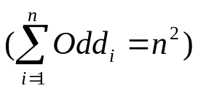
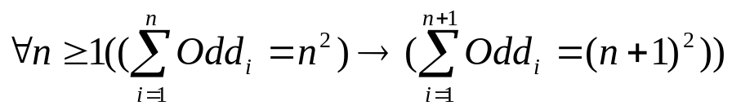
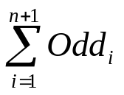
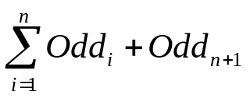
Sum of First n Positive Integers
Let Odd_{i} = 2(i – 1) + 1 denote the i^{th} odd positive integer. Then we can rewrite the claim as:
∀n ≥ 1
The proof of the claim is by induction on n:
Base case: take 1 as the base case. 1 = 1².
Prove:
=
= n²+ Odd_{n+1}. (Induction hypothesis.)
= n² + 2n + 1. (Odd_{n+1} = 2(n+1–1) + 1 = 2n + 1.)
= (n + 1)².

Slide 88
Pigeonhole Principle
Suppose that we have n pigeons and k holes. Each pigeon must fly into a hole. If n > k, then there must be at least one hole that contains more than one pigeon.
More formally,
Consider any function f: A → B.
The pigeonhole principle says:
If |A| > |B| then f is not one-to-one.

Slide 89
Cardinality
We will be concerned with three cases:
  finite sets,
  countably infinite sets, and
  uncountably infinite sets.
  A set A is finite and has cardinality n ∈ ℕ iff either:
        A = ∅, or
        there is a bijection from {1, 2, … n} to A,
        for some n.
  A set is infinite iff it is not finite.

Slide 90
Countably Infinite Sets
ℕ is countably infinite. Call its cardinality ℵ₀.
A is countably infinite and also has cardinality ℵ₀ iff there exists some bijection f : ℕ → A.
A set is countable iff it is either finite or countably infinite.
To prove that a set A is countably infinite, it suffices to find a bijection from ℕ to it.

Slide 91
Even Numbers
The set E of even natural numbers is countably infinite.
To prove this, we offer the bijection:
Even : ℕ → E,
Even(x) = 2x.
ℕ | E
0 | 0
1 | 2
2 | 4
3 | 6
… | …

Slide 92
Enumerations
Sometimes, bijection is not as obvious. Then a good way to think about the problem of finding a bijection from ℕ to some set A, is to turn it into the problem of finding an enumeration of A.
An enumeration of a set A is simply a list of the elements of A in some order. Each element of A must occur in the enumeration exactly once.

Slide 93
Enumerating Countably Infinite Sets
Theorem: A set A is countably infinite iff there exists an infinite enumeration of it.
Proof: We prove the if and only-if parts separately.
If A is countably infinite, then there exists an infinite enumeration of it: Since A is countably infinite, there exists a bijection f from ℕ to it. We construct an infinite enumeration of A as follows: For all i ≥ 1, the i^{th} element of the enumeration of A will be f(i - 1).
If there exists an infinite enumeration E of A, then A is countably infinite: Define f: ℕ → A, where f(i) is the (i+1)^{st} element of the list E. The function f is a bijection from ℕ to A, so A is countably infinite.
Note: used to show “countably infinite”, as well as “not countably infinite”

Slide 94
Finite Union
Theorem: The union U of a finite number of countably infinite sets is countably infinite.
Proof: by enumeration of the elements of U:
S₁[1], S₂[1], … S_{n}[1],
S₁[2], S₂[2], … S_{n}[2],
…
checking before inserting each element to make sure that it is not already there.
Can we do this? Enumerating all the elements of the 1st set, then the 2nd …
Notes:
The 1st set is infinite, we will never get around to consider any of the elements of the other sets …

Slide 95
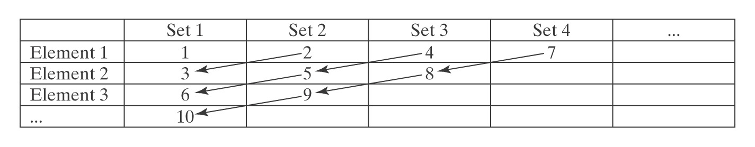
Countably Infinite Union
Theorem: The union U of a countably infinite number of countably infinite sets is countably infinite.
Proof: by enumeration of the elements of U.
Note: use the previous simple enumeration technique, we’d never et to the 2nd element of any sets …
check make sure the element not already there

Slide 96
Diagonalization
ℕ is countably infinite. Call its cardinality ℵ₀.
There are sets with more than ℵ₀ elements (not countably infinite)
  e.g., set of real numbers
The power set of the integers is not countable.
S is a countably infinite set, P(S) is not countable.
To prove it, use diagnonalization.
Proof by contradiction.
To show a set A is not countably infinite, we assume that it is, in which case there would be some enumeration of it. Every element of A would have to be on that list somewhere.
But we show how to construct an element of A that cannot be on the list, no matter how the list was constructed.
Thus, there exists no enumeration of A, so A is not countably infinite.

Slide 97
Diagonalization
S is a countably infinite set, P(S) is not countable.
 | Elem 1 of S | Elem 2 of S | Elem 3 of S | Elem 4 of S | Elem 5 of S | …….
Elem 1 of P(S) | 1 (1) |  |  |  |  | …..
Elem 2 of P(S) |  | 1 (2) |  |  |  | …..
Elem 3 of P(S) | 1 | 1 | (3) |  |  | …..
Elem 4 of P(S) |  |  | 1 | (4) |  | …..
Elem 5 of P(S) | 1 |  | 1 |  | (5) | …..
… |  |  |  |  |  | …..
A set that is not in the table:
¬(1) | ¬(2) | ¬(3) | ¬(4) | ¬(5) | …..

Slide 98
Reasoning About Programs
Correctness properties, including:
  The program eventually halts.
  When it halts, it has produced the desired output.
Performance properties, including:
  Time requirements, and
  Space requirements.

Slide 99
Proving Halting
To prove termination of a program P with a loop, we will generally rely on the existence of some well-founded set (S, R) such that:
There exists some bijection between each step of P and some element of the set S,
The first step of P corresponds to a maximal (with respect to R) element of S,
Each successive step of P corresponds to a smaller (with respect to R) element of S, and
P halts on or before it executes a step that corresponds to a minimal (with respect to R) element of S.

Slide 100
Choosing a Well-Founded Set
P(s: string) =
While length(s) > 0 do:
Remove the first character from s and call it c.
if c = a return True.
Return False.
Let S = {0, 1, 2, …, |s|}. (S, ≤) is a well-founded set whose least element is 0. Associate each step of the loop with |s| as the step is about to be executed. The first pass through the loop is associated the initial length of s, which is the maximum value of |s| throughout the computation. |s| is decremented by one each time through the loop. P halts when |s| is 0 or before (if it finds the character a). So the maximum number of times the loop can be executed is the initial value of |s|.

Slide 101
Proving a Program Computes Correct Result
Loop Invariants: a predicate I that describes a property that does not change during the execution of an iterative process.
Induction

Slide 102
Loop Invariants
To use a loop invariant I, we must prove:
I is true on entry to the loop.
The truth of I is maintained at each pass through the loop.
I, together with the loop termination condition, imply whatever property we wish to prove is true on exit from the loop.

Slide 103
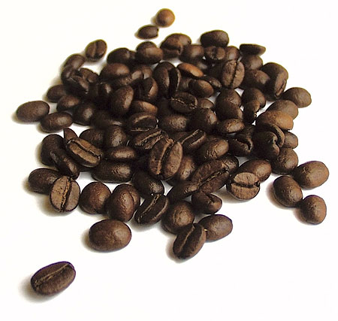
The Coffee Can Problem
Given a coffee can that contains some white beans and some black beans, do:
Until no further beans can be removed do:
  Randomly choose two beans.
  If the two beans are the same color, throw both of them away and add a new black bean.
  If the two beans are different colors, throw away the black one and return the white one to the can.
This process must halt.
What color is the remaining bean?
Notes:
white bean parity is preserved
If originally odd white beans, white
Otherwise, black

